Slide 1
MLOPS - DEPLOYMENT OF ML MODEL USING AWS SAGEMAKER
Under the guidance of: Mrs. SHANTALA C P
Prepared by:
NAINAZ [1CG18CS054]
NEHA R UTTARKAR [1CG18CS057]
ATIF JAWED [1CG18CS015]
KARTHIK GANESH [1CG18CS038]

Slide 2
INDEX
INTRODUCTION
PROBLEM STATEMENT
OBJECTIVES
SCOPE
SYSTEM ANALYSIS
WORKFLOW
IMPLEMENTATION
RESULT
CONCLUSION
REFERENCES

Slide 3
INTRODUCTION
Deploying an ML model in production is not the same as deploying other software application, it need specific life cycle, this cycle is called MLOps.
A generic workflow can be followed to Build, Train, Deploy, Monitor Machine learning application.
In Data science world machine learning is core approach to resolve the important life problems, today’s big data world ML plays vital role to produce best solution to customer nowadays.

Slide 4
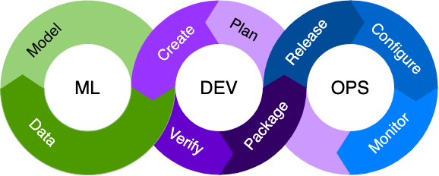
MLOPS
“Machine Learning Operations (MLOps) is the discipline of delivering machine learning(ML) models through repeatable and efficient work flow.”
MLOps enables the continuous delivery of high-performance ML application into production environment.
It includes all the capability that Data science, Product teams, and IT need to Build, Train, Deploy, Operate, Govern and secure ML models in production.

Slide 5
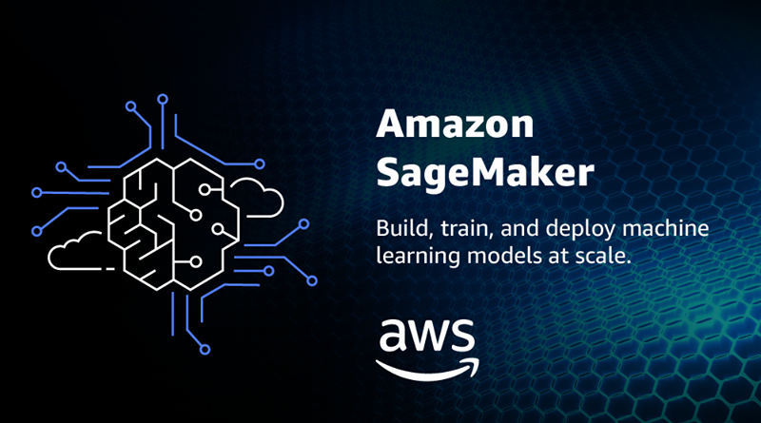
AWS (Amazon Web Service)
“Amazon Web Services (AWS) is a cloud service from Amazon, which provides services in the form of building blocks, these building blocks can be used to create and deploy any type of application in the cloud.”
AWS provide the Amazon Sagemaker, is a fully managed machine learning service.
With sagemaker data scientists and developers can quickly and easily build and train ML models, and then directly deploy models into a production environment.
It provide an integrated Jupyter notebook EC2 Instance for easy access to your data sources for exploration and analysis.
Sagemaker provide a built in machine learning algorithms.

Slide 6
PROBLEM SATAEMENT
There has been increasing interest in the rapid deployment of ML features.
Often the model, which can be the core of application is just a small part of the whole software system.
Since the development and operational phase is being carried out separately, the process of model building, training, and deployment is time consuming and robust process.

Slide 7
OBJECTIVES
The objective of this project is to automate the deployment of ML models into the core software system or as a service component.
Deploy the diabetes prediction model in Amazon sagemaker to predict whether a person has diabetes or not based on 8 features.
----- XGBoost Classifier-----
Amazon sagemaker reduces the time and cost of pushing this model into production.

Slide 8
SCOPE
The tremendous amounts of projects have been deployed using machine learning, there is still scope for more.
Adopting AWS practice gives faster time to market for ML project by delivering the following benefits:
Productive
Repeatability
Reliability
Auditability
Data and Model quality

Slide 9
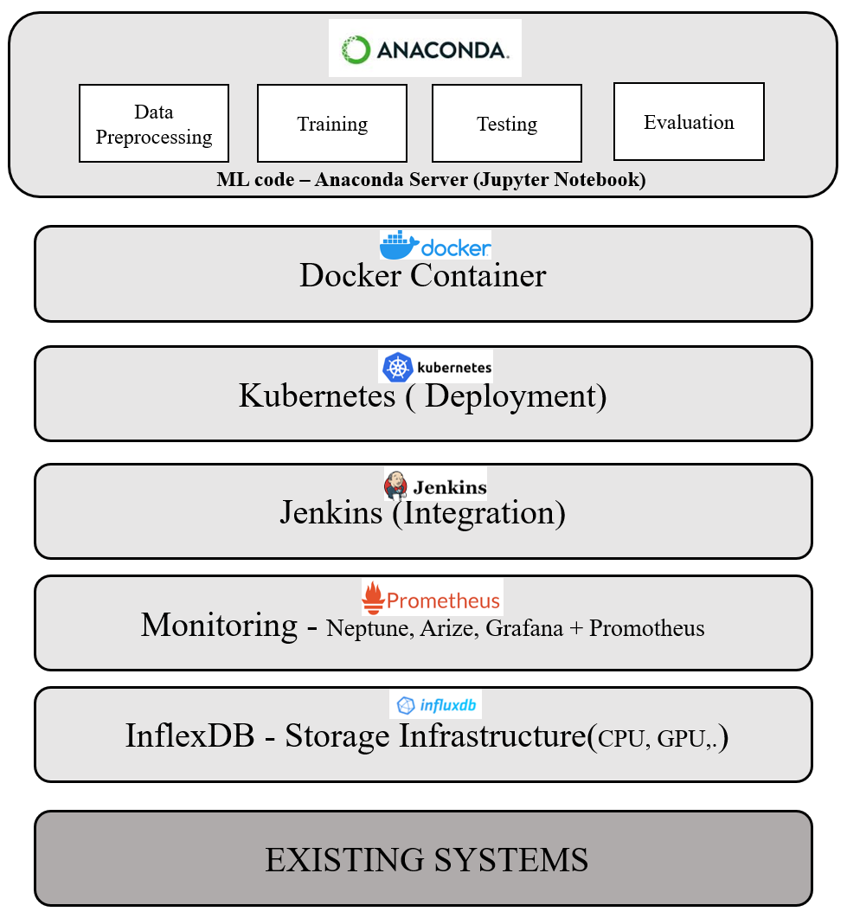
SYSTEM ANALYSIS
EXISTING SYSTEMS
To create the whole ML model we used separate tools, to perform each task such as: ML code, Containerizing the model, Model deploy, Integration, Model monitoring and so on.,

Slide 10
PROPOSED SYSTEM
AWS (Amazon Web Service) is a cloud service platform, which provides services in different domains such as compute, storage, delivery and other functionality.
Amazon sagemaker is a powerful service provided by amazon.
It provide ML developer the ability to build, train, and deploy machine learning model quickly.
Sagemaker provide the notebook instance, in which ML model can be build, train and deploy.
Delivering a computing power i.e CPU, Ram, Storage etc services to the end users over Network (Internet) rather than a physical machine.

Slide 11
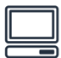




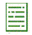
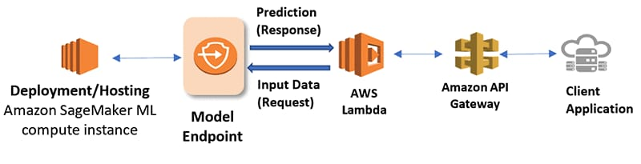

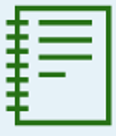
WORKFLOW
Web Browser
S3 Bucket
Data Analysis
Amazon Sagemaker
Splittng Dataset
Model Training
Model Endpoint
Model Deployment
Notebook Instance
Notebook Instance

Slide 12
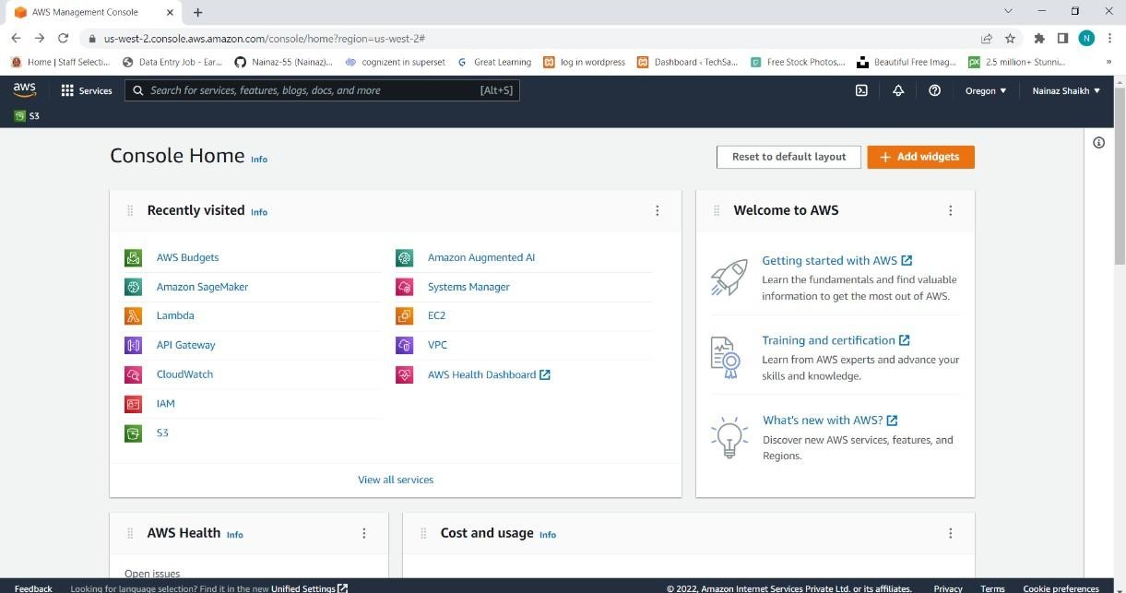
IMPLEMENTATION
AWS (Amazon Web Service)
A user creates a standalone AWS account. When the account is fully activated, we have full access to all AWS services.
AWS Management console

Slide 13
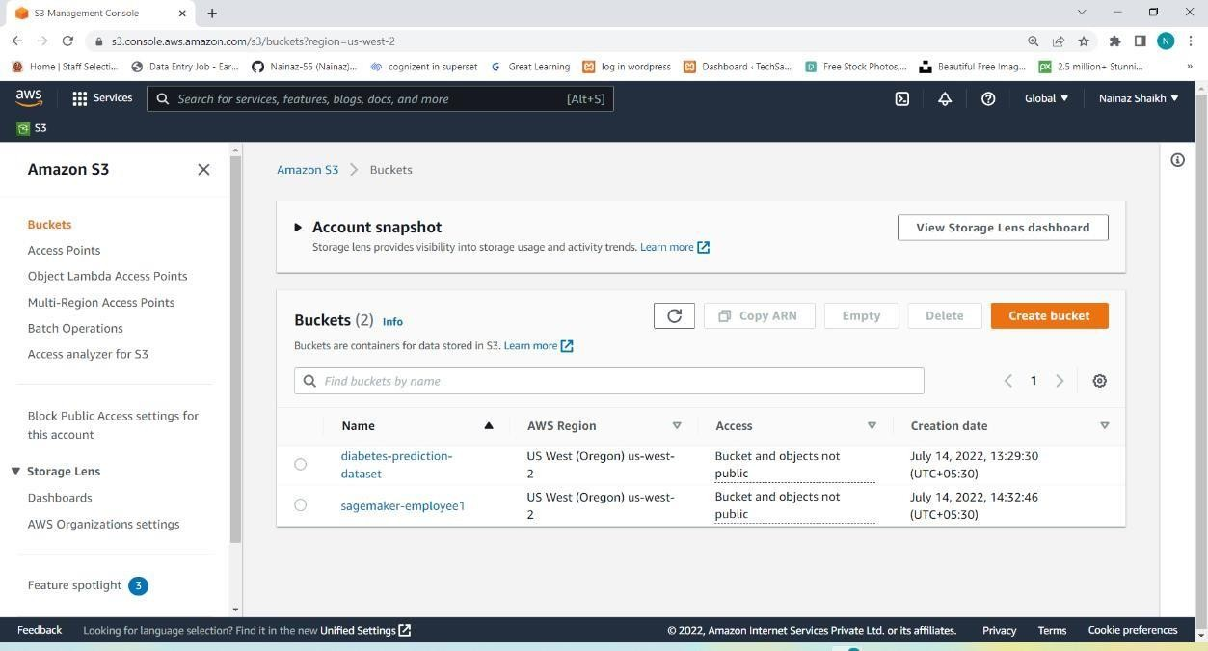
S3 Bucket
It is cloud storage service, designed for online backup and storing a data and the code on Amazon Web Services (AWS).
Creating a S3 Bucket

Slide 14
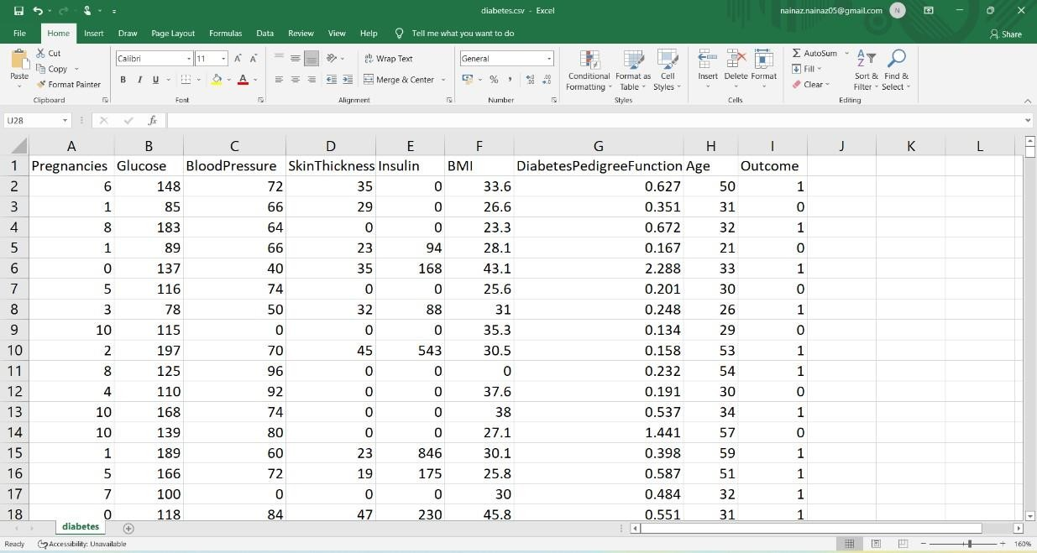
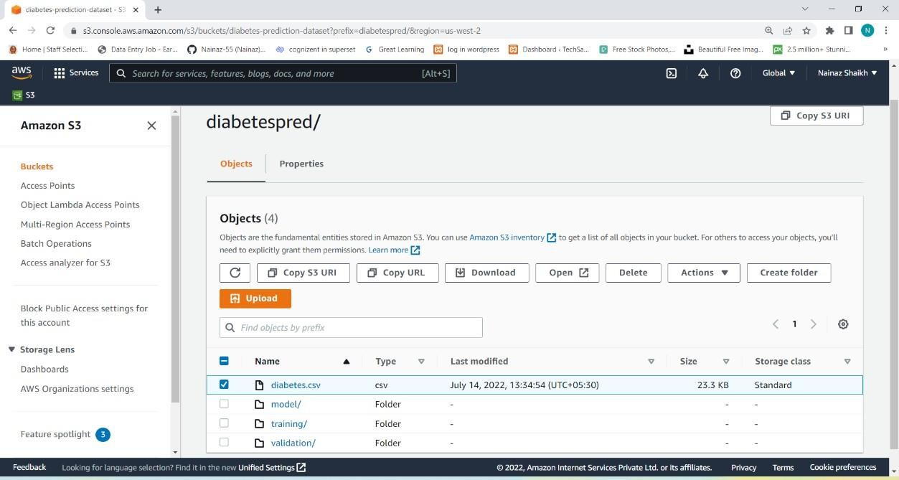
This dataset is originally from the National Institute of Diabetes and Digestive and Kidney Diseases. https://www.kaggle.com/uciml/pima-indians-diabetes-database
It has 768 instances and 9 attribute.
Diabetes prediction dataset
The dataset is uploaded into the S3 bucket and creates a folder (training, validation, and model) to store the training dataset, validation dataset, and trained model.
Upload Dataset to S3 Bucket

Slide 15
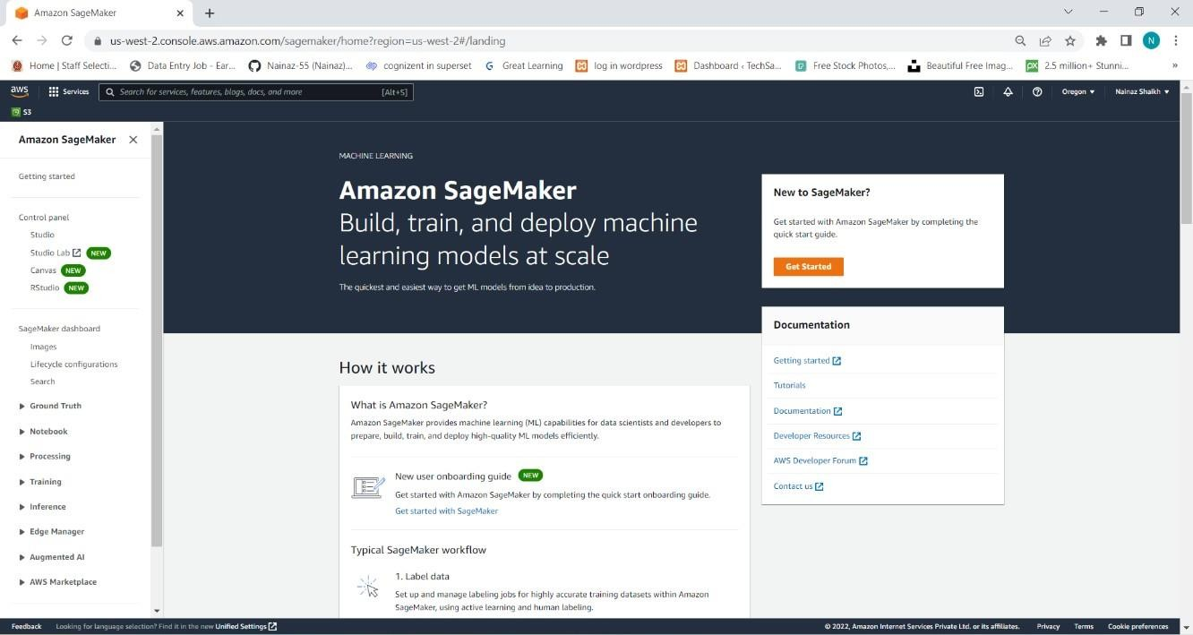
Amazon Sagemaker
Amazon SageMaker is a managed service in the Amazon Web Services (AWS) public cloud. It provides the tools to build, train and deploy machine learning (ML) models for production environment.
Amazon Sagemaker console

Slide 16
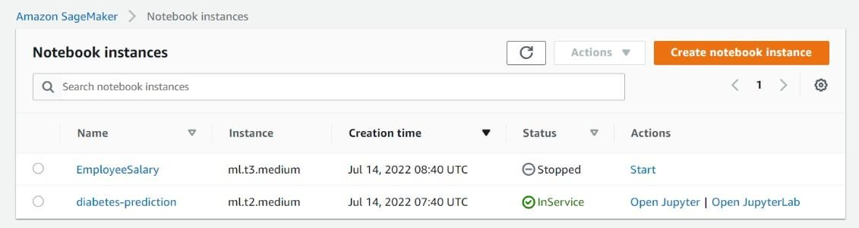
Notebook Instance
An Amazon SageMaker notebook instance is a fully managed machine learning (ML) Amazon Elastic Compute Cloud (Amazon EC2) instance that runs the Jupyter Notebook. Where we can build, train, and deploy an ML models.
Creating a Notebook instance
Data Analysis: Exploratory Data Analysis (EDA) is an approach to analyze the data using visual techniques.
We used a correlation heatmap to find the correlation between each attribute of the dataset. And We plot the boxplot to find the significant outlier in the each attribute.

Slide 17
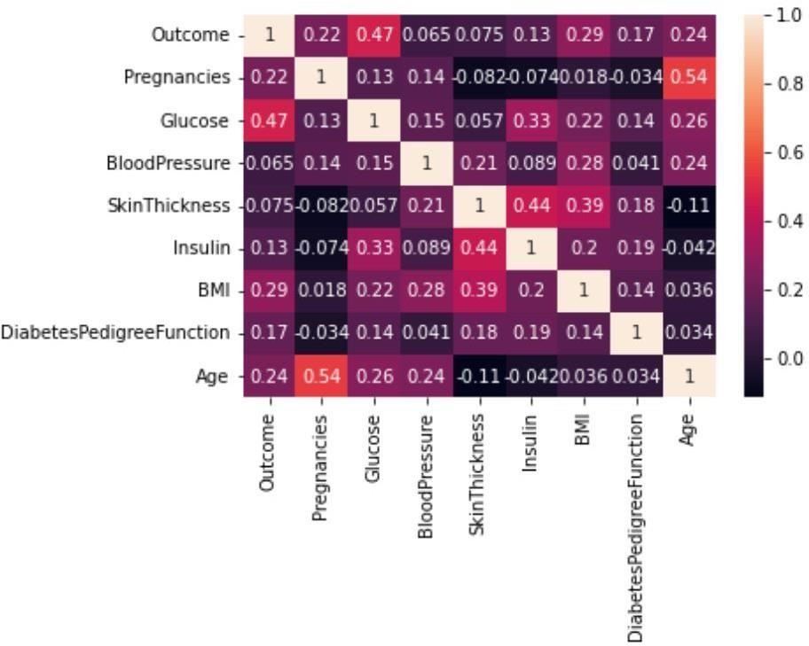
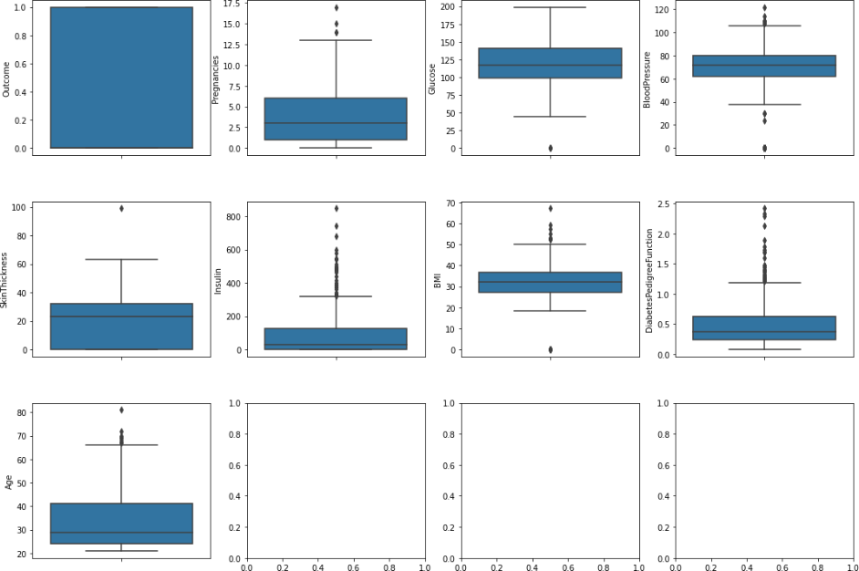
Correlation between the each attribute
To check outliers in the each attribute

Slide 18
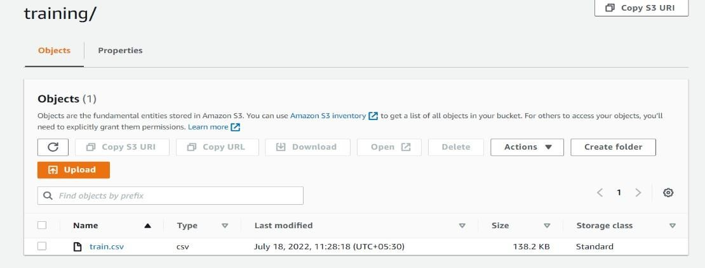
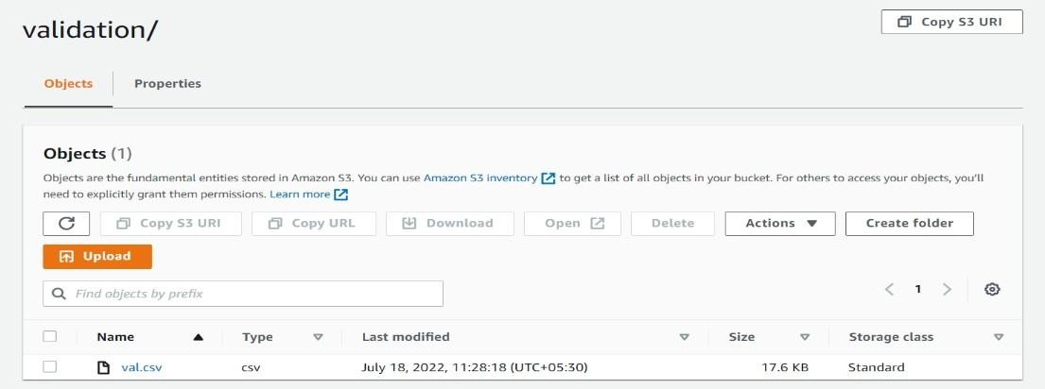
Splitting Dataset: After data analysis, we split dataset into training and validation data, then saves this train and validation data by writing it back to S3 bucket in training and validation paths respectively
Training dataset in S3
Validation dataset in S3

Slide 19
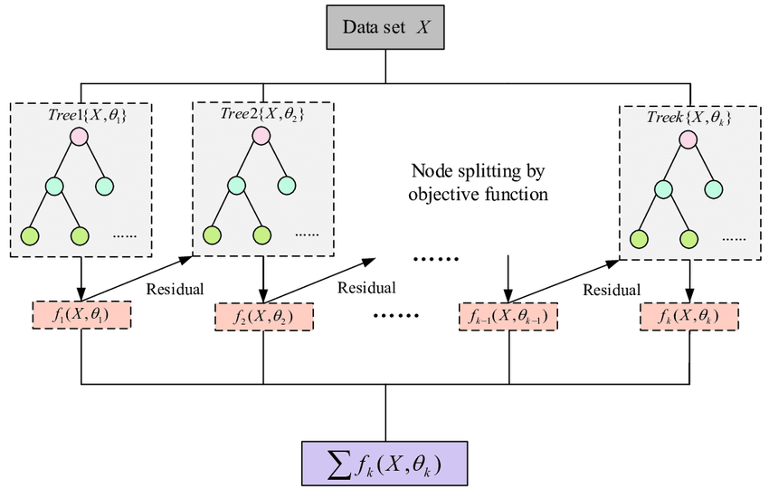
Model Training: XGBoost Classifier Algorithm
XGBoost, stands for Extreme Gradient Boosting,
XGBoost model uses a boosting technique, In Boosting technique the errors made by previous models are tried to be corrected by succeeding models by adding some weights to the models.
XGBoost Classifier Architecture

Slide 20
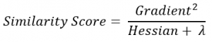
Algorithm::
Step 1: Create a single leaf tree.
Step 2: For the first tree,
Compute the average of target variable as prediction and calculate the residuals using the desired loss function.
For subsequent trees,
The residuals come from prediction made by previous tree.
Step 3: Calculate the similarity score using the following formula:
Where, Hessian is equal to number of residuals,
Gradient2 is squared sum of residuals,
λ is regularization parameter.
Step 4: Using similarity score we calculate Information gain. Information gain gives the difference between old similarity
and new similarity and thus tells how much homogeneity is achieved by splitting the node at a given point. It is
calculated using the following formula:

Slide 21
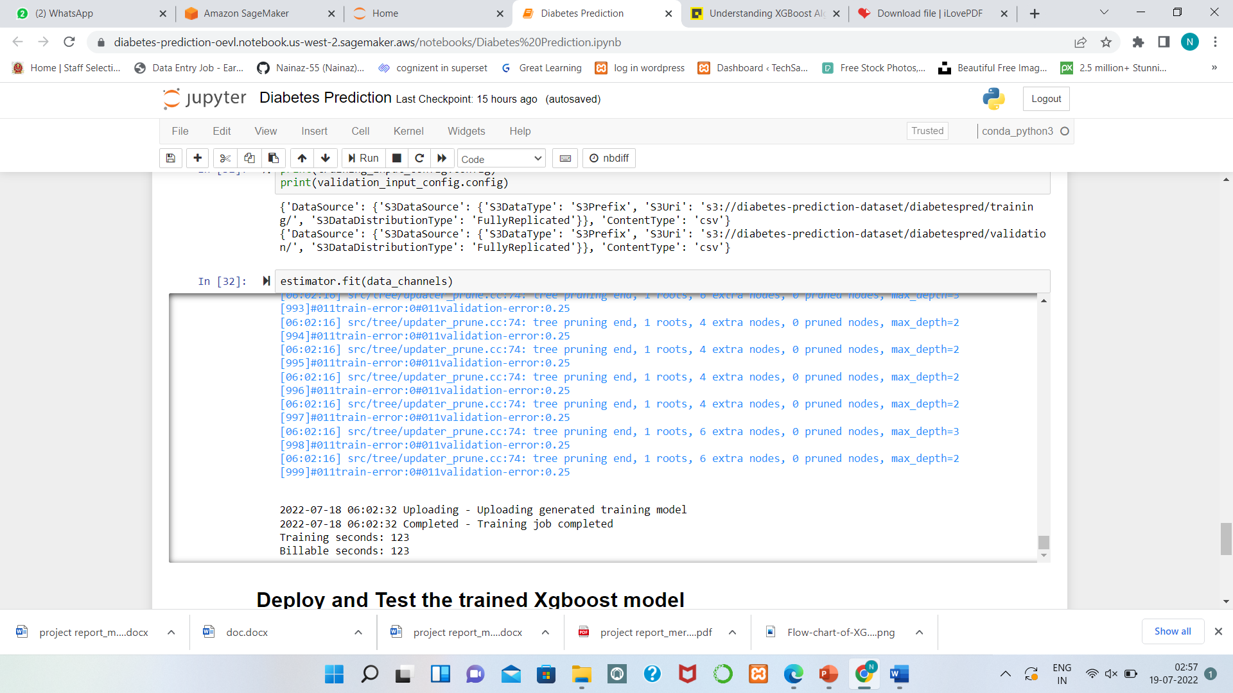
Step 5: Create the tree of desired length using the above method. Pruning and regularization would be done by playing with
the regularization parameter.
Step 6: Predict the residual values using the Decision Tree we constructed.
Step 7: The new set of residuals is calculated using the following formula:
where, ρ is the learning rate.
Step 8: Go back to step 1 and repeat the process for all the trees.
Model Training

Slide 22
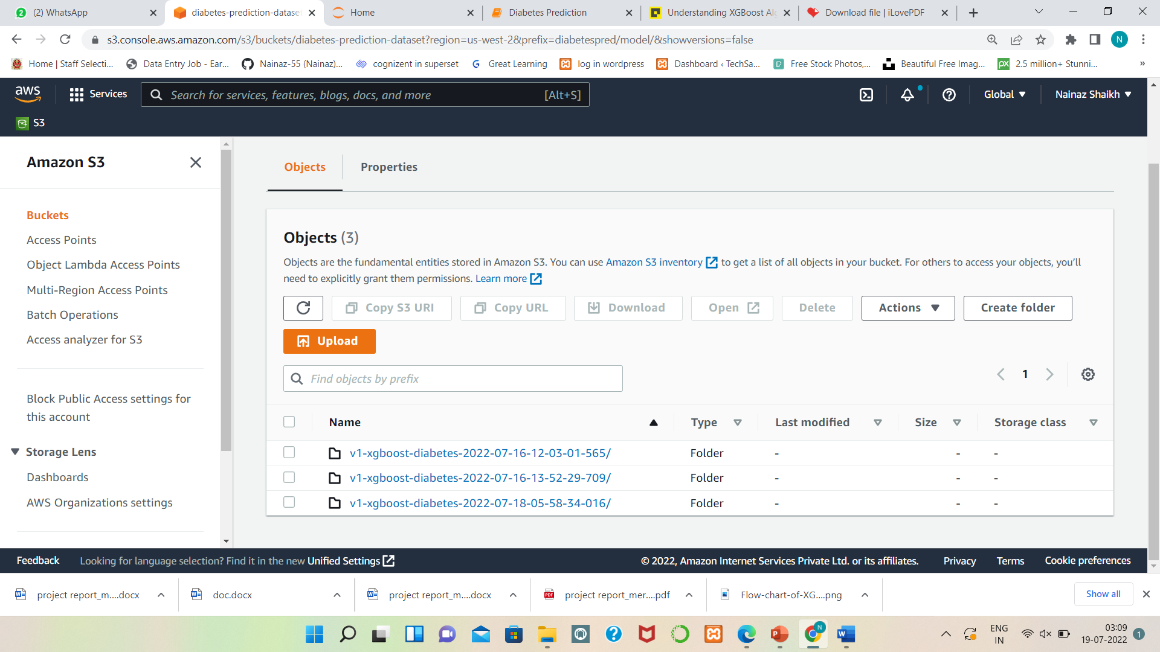
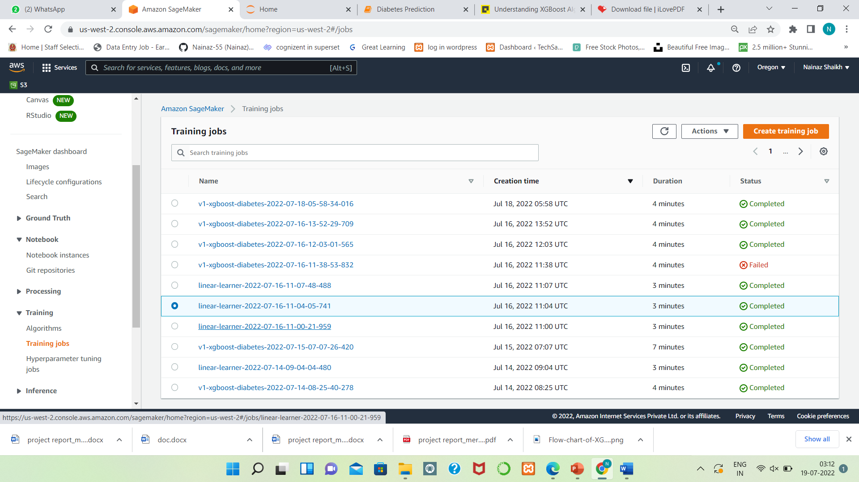
Trained model stored into S3
Training Jobs

Slide 23
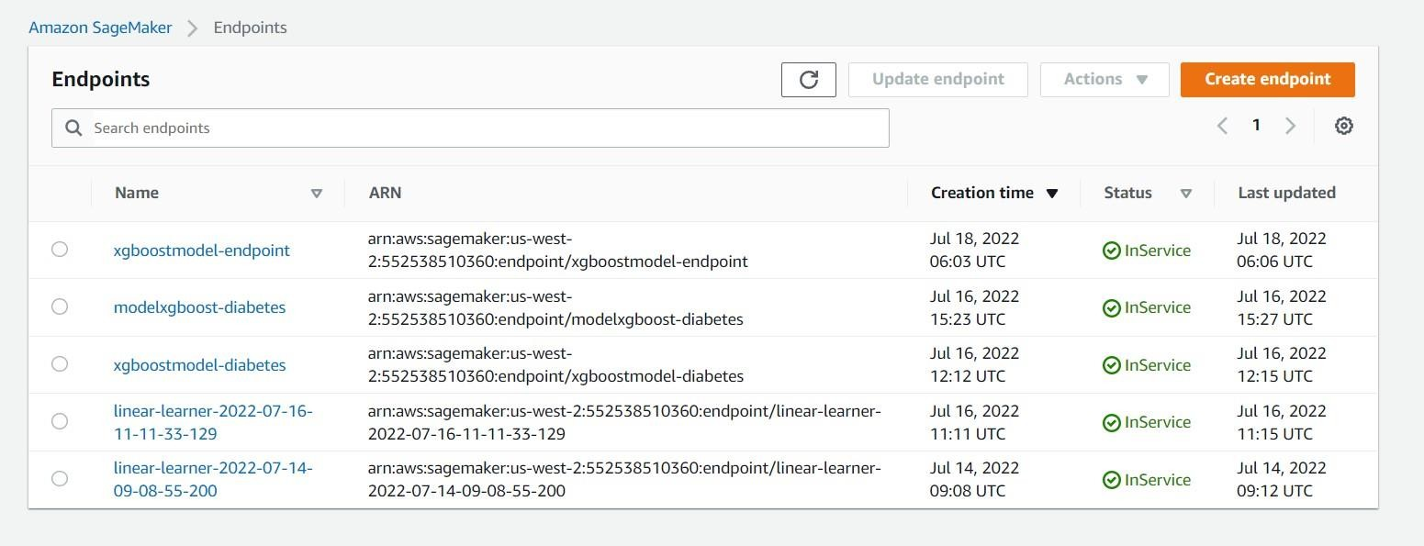
Model deployment: Deployment is the method by which we integrate a machine learning model into an existing production environment to make practical business decisions based on data.
Deploying trained model
Endpoint creation: Endpoint is basically where our clients will get the result whether the person has diabetes or not by inputting the numerical values.
Model Endpoints

Slide 24
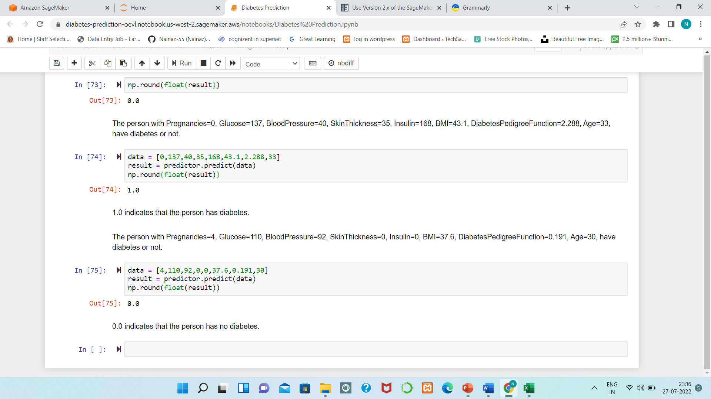
RESULT
XGBoost model is learned by using the diabetes prediction dataset to predict whether the person has diabetes or not based on the features of that person, deployed it into production environment and endpoint is created
Predicting whether the person has diabetes or not

Slide 25
CONCLUSION
Firstly, we highlighted the technical challenges we faced, and then we addressed them within our solution.
We presented an Amazon sagemaker as a system where we can write code to Build, Train, Deploy ML model.
We described the key design consideration and technical architecture of Amazon sagemaker, where we discussed the methodology for diabetes prediction and deployment insight.
Our system is scalable, cloud based, fully managed diabetes prediction model designed to cater the needs of customer from different healthcare industries.
The experience and insight form our work are likely to be useful for researchers and practitioners working in the emerging field of machine learning operations (MLOps).

Slide 26
REFERENCES
Machine Learning Ops (MLOps): In-depth Guide UPDATED ON October 8, 2021 PUBLISHED ON June 8, 2021 Written by Cem Dilmegani https://research.aimultiple.com/mlops/
Pima Indians Diabetes Database https://www.kaggle.com/datasets/uciml/pima-indians-diabetes-database.
Best MLOps Platforms to Manage Machine Learning Lifecycle, Author Harshil Patel, Updated July 21st2022 https://neptune.ai/blog/best-mlops-platforms-to-manage-machine-learning-lifecycle
Explain the step by step implementation of XGBoost Algorithm. Monis Khan, https://www.csias.in/explain-the-step-by-step-implementation-of-xgboost-algorithm/
Understanding XGBoost Algorithm In Detail By Jayita Bhattacharyya, https://analyticsindiamag.com/xgboost-internal-working-to-make-decision-trees-and-deduce-predictions/
MLOps vs. DevOps: What is the Difference? Safwan Islam February 25, 2022 https://www.phdata.io/blog/mlops-vs-devops-whats-the-difference/
Building a DevOps Pipeline for Machine Learning and AI: Evaluating Sagemaker Ashley Binford Jul 17, 2019 https://towardsdatascience.com/building-a-devops-pipeline-for-machine-learning-and-ai-evaluating-sagemaker-cf7fdd3632e7
Who Needs MLOps: What Data Scientists Seek to Accomplish and How Can MLOps Help? Sasu Mäkinen; Henrik Skogström; Eero Laaksonen; Tommi Mikkonen https://ieeexplore.ieee.org/document/9474355/authors#authors

Slide 27
THANK YOU

